Slide 1
Digit Recognition
CS 4701 AI Practicum
Hsiao-Tung Chen, Cheng-Han Lin
Professor Bart Selman

Slide 2
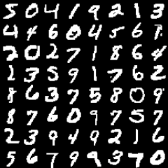
Goal- Recognize Handwritten Digits
Practical Application:
Read digits on license plates, checks, mail envelopes, etc.
Saves time and cost.

Slide 3
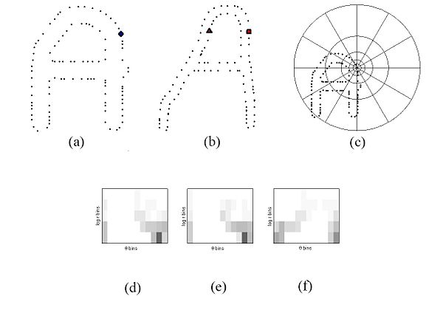
Learning Algorithms for Classification
First step: meaningful feature extraction:
Raw Image
GIST Descriptor
Shape Context

Slide 4
Learning Algorithms for Classification
Each digit number 0 to 9 is a class.
Training data and test data consists of a class label and pixel intensities
k-nearest neighbor (kNN)
support vector machine (SVM)
neural network (NN) and convolutional neural network (CNN)

Slide 5
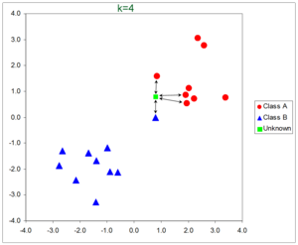
K-Nearest Neighbor- kNN
Predict the label of query image from the majority class of its nearest neighbors.
Find the k most similar images (nearest neighbors) with smallest Euclidean distances.
Varied k from 1 to 20 to find the most effective parameter.
Feature 2
Feature 1

Slide 6
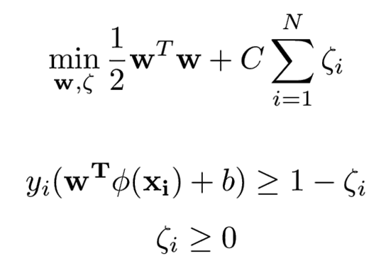
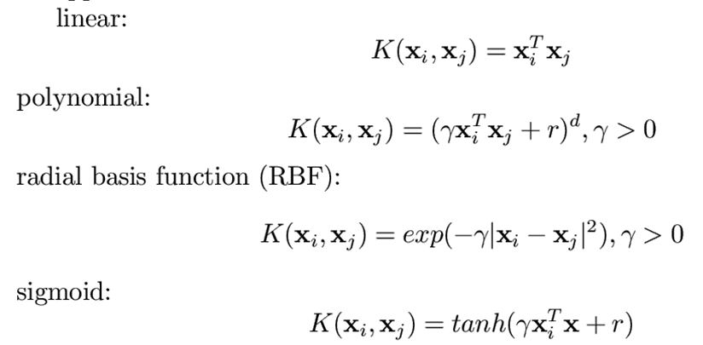
Support Vector Machine- SVM
Separate examples by a hyperplane that maximizes the margin.
Examples mapped to higher dimensional feature space to account for all features.
Kernelize SVM:

Slide 7
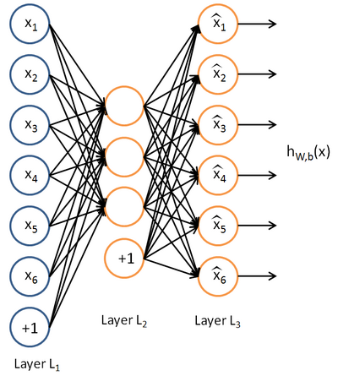
Neural Network
f: X -> Y, where X inputs are the features and Y is the output class.
Weighted sum of inputs feed into a node. The node fires the activation function value if hit threshold.

Slide 8

Neural Network
Optimize weights by backpropagation from output layer:
Error of kth output node:
weight update rule:

Slide 9
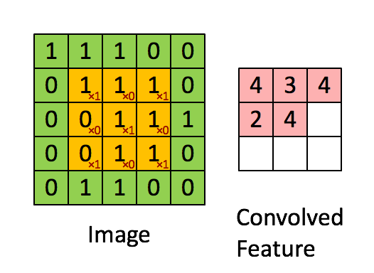
Convolution Neural Network
Convolution: Apply a small-size filter over an image at all possible offsets to produce a smaller image.
Feature maps represent a series of overlapping receptive fields with sparse connectivity. Each feature map now is more responsive to a larger area of pixel space.

Slide 10
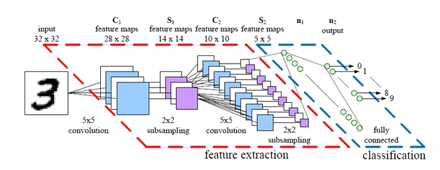
Convolution Neural Network
Pooling/Subsampling: pick maximum pixel intensity of a say 2x2 pixel grid
Enhances translational invariance- detection of similar or same feature could be translated across to different position on the image.
Produces maps of high level features that can be used to more efficiently discern image features. .
Also, less inputs mean less weights to optimize so neural networks can potentially go deeper (have more layers) to be a better classifier.
In general, convolution
increases classification
accuracy and reduces
training time.

Slide 11
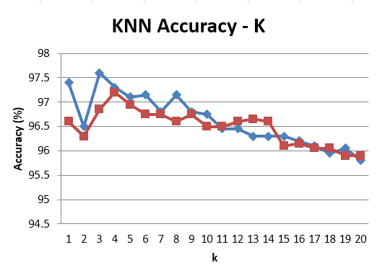
kNN Results
Raw: 96.62%
Gist: 96.48%
SC: 9.95%
When k equals to 3 or 4 the learning algorithm could reach the highest accuracy.

Slide 12
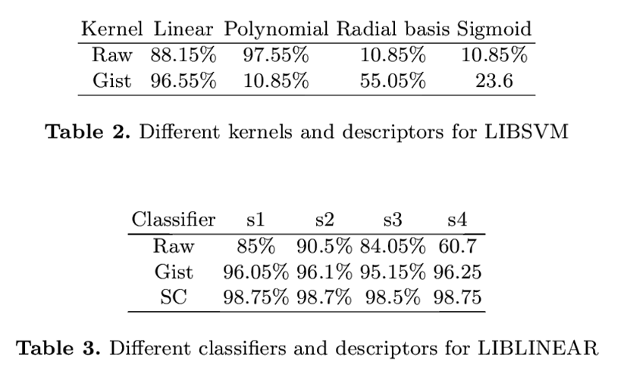
SVM Result
For raw descriptor, the polynomial kernel has high accuracy 97.55%.
For gist descriptor, linear kernel have the highest accuracy 96.55%.
Most of the cases have good performance under linear SVM especially when we apply shape context as descriptor: accuracy 98.75%.

Slide 13
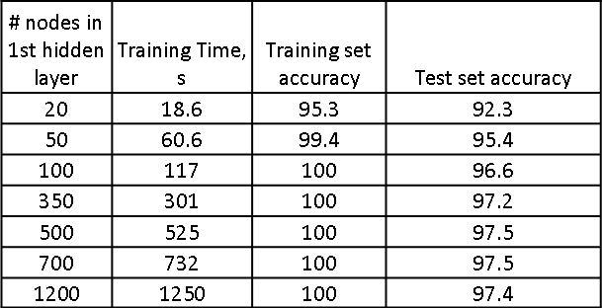
Neural Network & Convolutional Neural Network
Neural Network: Test set accuracy increases with more number of hidden layer nodes but plateaued at around 400 nodes.

Slide 14
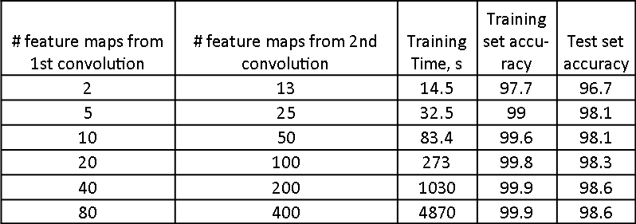
Neural Network & Convolutional Neural Network
Convolutional Neural Network: Test set accuracy increases with more number of feature maps from convolution but plateaued at around 20 and 100 maps

Slide 15
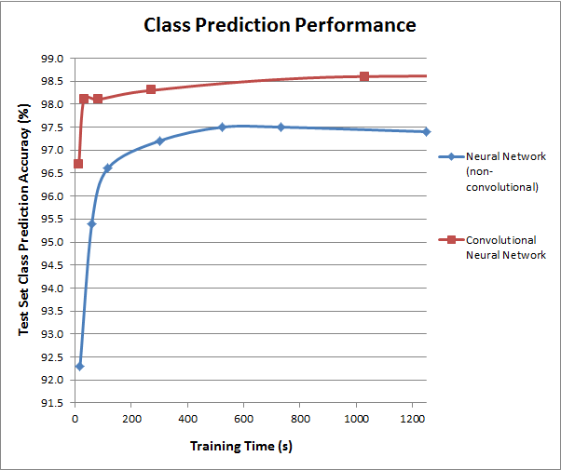
Neural Network & Convolutional Neural Network
Given the same training time, convolutional neural network model predicted digits (98.6%) more accurately than regular neural network model (97.5%).
However, the accuracy improvement was small, only less than 1.5% given the same training time.

Slide 16
Discussion
kNN: Raw: 96.62%, Gist: 96.48%
SVM:
- For raw descriptor, the polynomial kernel has high accuracy at 97.55%.
For gist descriptor, linear kernel has highest accuracy at 96.55%.
Most of the cases have good performance under linear SVM, especially when we apply shape context as descriptor: 98.75%.
Neural Network: Given the same training time, convolutional neural network model predicted digits (98.6%) more accurately than regular neural network model (97.5%).

Slide 17
Conclusion
Best Classifiers:
Linear SVM with shape context as descriptor: accuracy 98.75%
Convolutional neural network model: accuracy 98.6%

